Slide 1
Graphics Parts and Terms
B. Ricks, PhD
CS 4620, University of Nebraska at Omaha

Slide 2
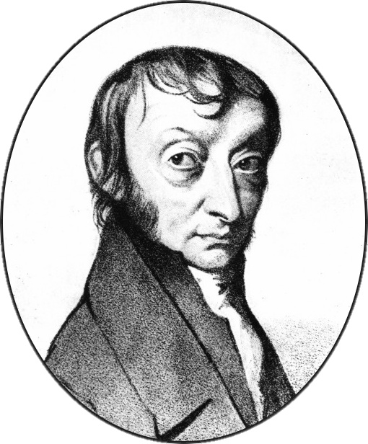


Fundamental Problem of Graphics
Avogadro’s number
$$N=6.02214076× {10}^{23}$$
The number of particles in a mole.
602,214,076,000,000,000,000,000
Water
A little more than a tablespoon of water contains about a mole of water molecules.
AMADEO AVOGADRO
Amedeo Carlo Avogadro
(1776-1856). The constant is named after Avogadro, even though he did not discover it. Avogadro’s scientific contributions focused on gases.
TABLESPOON DERIVATION
18.0153 g = 1 mole water
~236 g/cup of water
236/13=18.15
1/13 cup=1.2 Tbsp
Portrait in Public Domain, tinyurl.com/wkcite?curid=8947961. See Wikipedia’s page for Avogadro and Avogadro’s constant. Photo by zhang kaiyv, under Pexels’ permissive license.

Slide 3
Basic 3D Object Representation
Vertex (pl. Vertices)
Face
A location in 3D space represented by a column vector: [x,y,z,1]^{T}
The last dimension is called W and is always 1.
Ideally, a set of vertices that, when connected in order with edges, creates a flat, enclosed surface.
For a GPU to render a face, the face needs to be be represented by triangles. Triangle remove any ambiguity because they are always flat.
Line (or Edge)
Two connected vertices. Mathematically, a line or edge represents the segment of an infinite line.

Slide 4
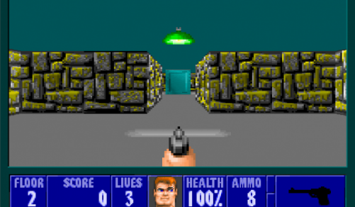
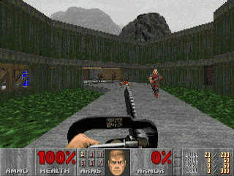
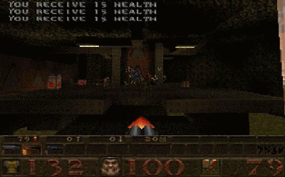
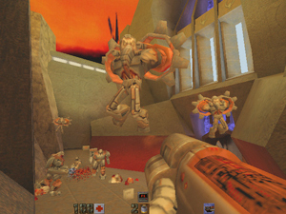
By The image may be obtained from id Software, Fair use, https://en.wikipedia.org/w/index.php?curid=8393749
History of Games and GPUs
Wolfenstein3D
2.5D Rectilinear
May 1992
Doom
2.5D Heightfield
December 1993
Quake I
Full 3D June 1996
GPU January 1997
Quake II
Full 3D GPU December 1997
Internet Boom
‘92
‘93
‘94
‘95
‘96
‘97
All images may be obtained from id Software, Fair use, e.g. https://en.wikipedia.org/wiki/Template:Non-free_use_rationale_video_game_screenshot. Sources: https://www.geek.com/wp-content/uploads/2012/05/Screen-Shot-2012-05-09-at-9.41.19-AM-625x352.png, https://en.wikipedia.org/w/index.php?curid=491802, https://en.wikipedia.org/w/index.php?curid=47349045, https://en.wikipedia.org/w/index.php?curid=15579986. See also Wikipedia articles about the respective games.

Slide 5
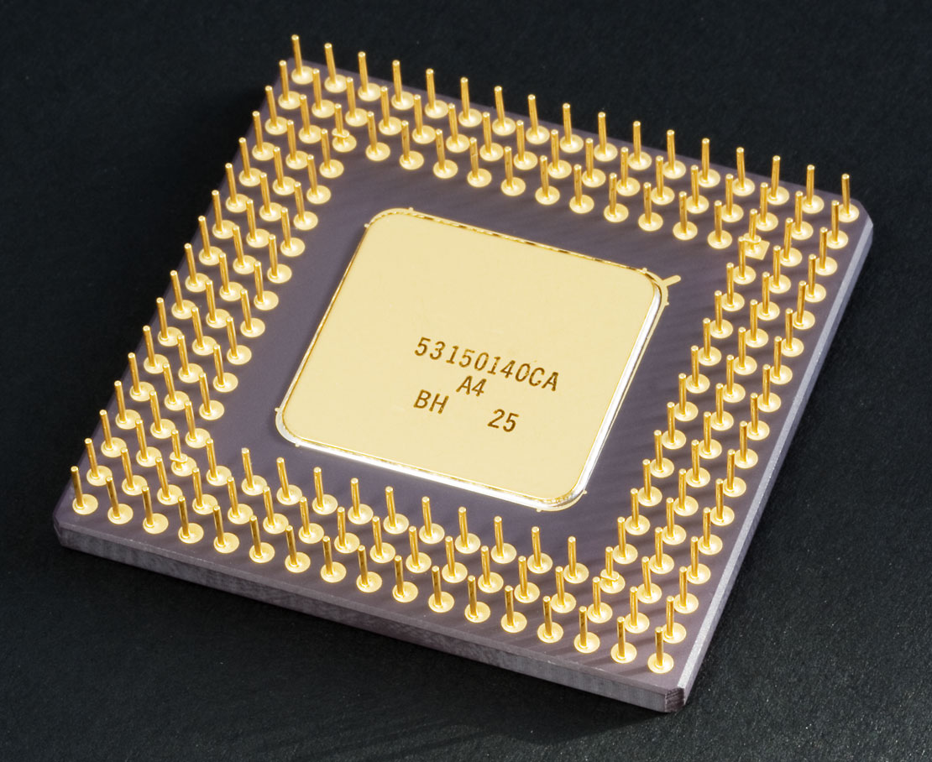
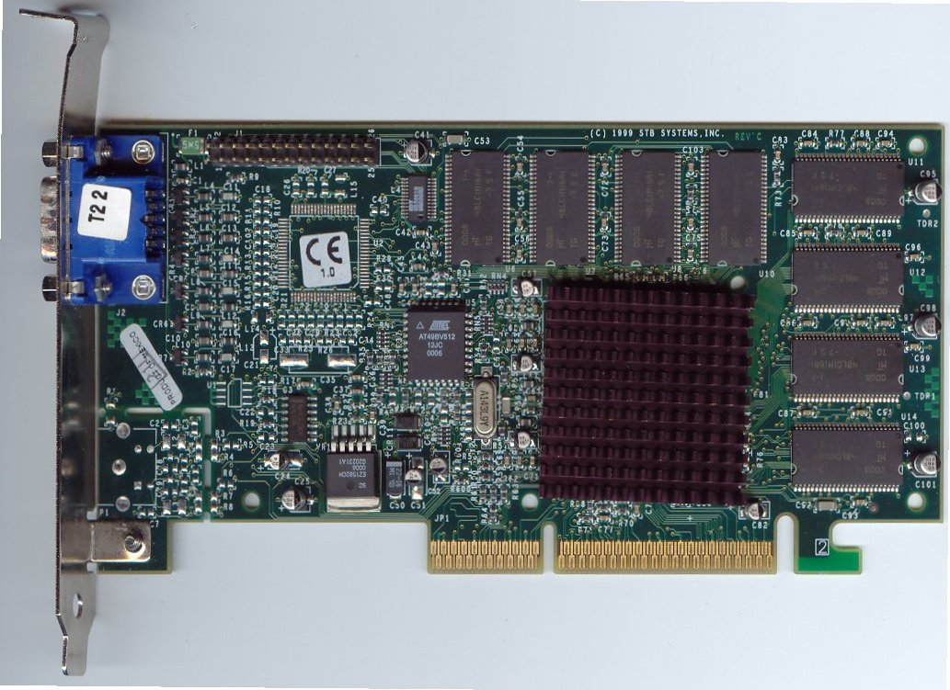
CPUs v. GPUs
GPU
CPU
Origins in Calculators
Originally designed for serial operations on a large instruction set.
When parallelized, can do different instructions.
Origins in Monitors
Originally designed for parallel operations on a small instruction set.
Does the same instruction in parallel
Runs small programs called shaders.
CPU Image, CC BY-SA 2.0, https://commons.wikimedia.org/w/index.php?curid=406957
GPU Image, By Swaaye at the English language Wikipedia, CC BY-SA 3.0, https://commons.wikimedia.org/w/index.php?curid=6037820

Slide 6
Z Buffer
Rasterizing
 |  |  |  | Frame 1 | Frame 1 | Frame 2 | Frame 2
Z Buffer Contents
Clear Z Buffer
[Vertex Shader]
Rasterize triangles to Z Buffer
[Fragment Shader]
For each pixel on the Z Buffer,
Calculate color
Closest Depth
Closest Depth reference
RGB(A) color
Screen Tearing
To avoid screen tearing, write to a background buffer instead of writing to the screen. (Double/triple buffering).
Z Thrashing
GPU are parallel. Two points with the same Z may “fight” over who is closer.

Slide 7
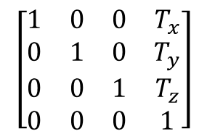
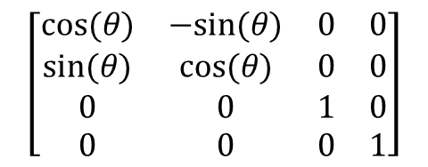
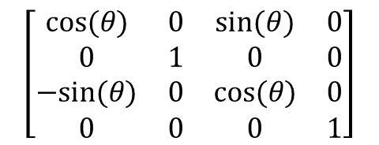
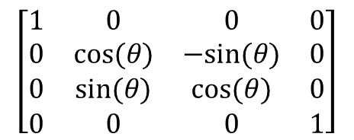
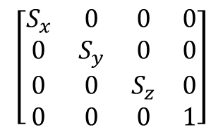
Matrix Review
Rotation
Scale
3D v 4D Transformations
Some transformations can be represented by 3D matrices (scale and rotation) while others need 4D matrices (translation and projection). For consistency, we always use 4x4 matrices.
$$\left[\begin{matrix}1 & 0 & 0 & 0 \\ 0 & cos⁡(θ) & −sin⁡(θ) & 0 \\ 0 & sin⁡(θ) & cos⁡(θ) & 0 \\ 0 & 0 & 0 & 1\end{matrix}\right]$$
$$\left[\begin{matrix}S_{x} & 0 & 0 & 0 \\ 0 & S_{y} & 0 & 0 \\ 0 & 0 & S_{z} & 0 \\ 0 & 0 & 0 & 1\end{matrix}\right]$$
About X
$$\left[\begin{matrix}cos⁡(θ) & 0 & sin⁡(θ) & 0 \\ 0 & 1 & 0 & 0 \\ −sin⁡(θ) & 0 & cos⁡(θ) & 0 \\ 0 & 0 & 0 & 1\end{matrix}\right]$$
About Y
Translation
$$\left[\begin{matrix}1 & 0 & 0 & T_{x} \\ 0 & 1 & 0 & T_{y} \\ 0 & 0 & 1 & T_{z} \\ 0 & 0 & 0 & 1\end{matrix}\right]$$
$$\left[\begin{matrix}cos⁡(θ) & −sin⁡(θ) & 0 & 0 \\ sin⁡(θ) & cos⁡(θ) & 0 & 0 \\ 0 & 0 & 1 & 0 \\ 0 & 0 & 0 & 1\end{matrix}\right]$$
4D Vectors
About Z
3D Vectors become 4D by adding another dimension, w. w always has a value of 1.

Slide 8

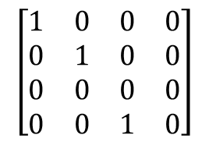
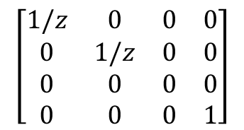
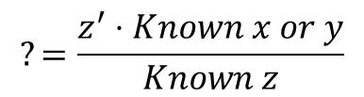

Vertex Shaders + Projection
Perspective
Using Similar Triangles
Model Space
How do x and y scale as z changes?
$$?=\frac{z^{′}⋅Known x or y}{Known z}$$
[Rotate][Scale][Translate]
Model specific
Perspective Matrix
World Space
$$\left[\begin{matrix}1/z & 0 & 0 & 0 \\ 0 & 1/z & 0 & 0 \\ 0 & 0 & 0 & 0 \\ 0 & 0 & 0 & 1\end{matrix}\right]$$
[Rotate][Scale][Translate]
Generic
Known
x or y
Camera Space
?
- Or -
Known distance to image plane, z$′$
$$\left[\begin{matrix}1 & 0 & 0 & 0 \\ 0 & 1 & 0 & 0 \\ 0 & 0 & 0 & 0 \\ 0 & 0 & 1 & 0\end{matrix}\right]$$
[Projection]
Generic
Known z
Screen Space

Slide 9
Vertex + Fragment Shaders
Vertex Shader
Fragment Shader
Declarations
A structure for what data the vertex shader needs.
Declaration of external variables.
Structure for what data the vertex shader will pass to the fragment shader.
Given data in the input structure (usually model space data), populate the output structure (usually screen space)
Given the data in the output structure, what color should be at this pixel?
Shader Dialects
Online Shader “Playgrounds”
Most shaders are written in HLSL (DirectX) or GLSL (OpenGL). The concepts are similar, but the fine points of syntax are different.
Fun places to practice shaders:
https://shadertoy.com (fragment only)
https://shaderfrog.com (both)

